Slide 1
Multimodal Depression Detection and Severity Estimation
Achyut Shukla
Aparna Anand
Avik Basu
Indhu Kamala Kumar
Madhusudhan Krishnamachari

Slide 2

Introduction
Mental disorder that affects daily life.
Leads to fatigue, insomnia, weight loss, weight gain, etc.
350 million+ people affected by depression
Hence, diagnosis and treatment of depression is important.

Slide 3
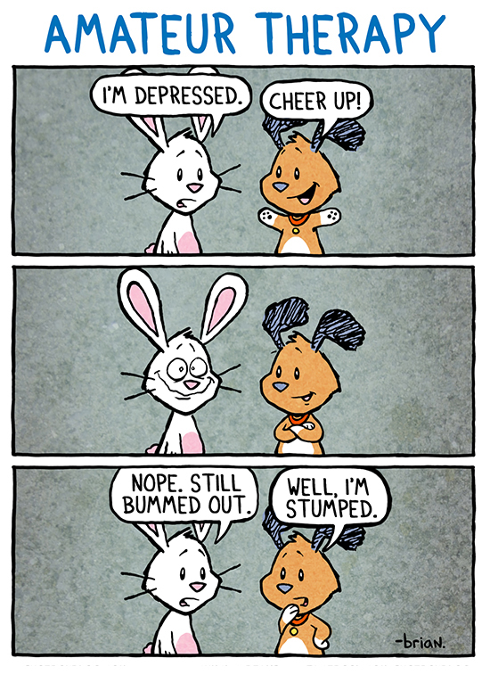
Are doctor examinations accurate?
Classical approach to identify depression – interview, questionnaires.
Not reliable – patients might not provide accurate information.
Constrained – Patients can’t express themselves fully.
Patients not comfortable during dyadic interviews.

Slide 4
Can machines detect depression?
Yes they can! – Machine Learning + AI problem.
Lots of work done by USC – DeVault et al, Ghosh et al, Scherer et al, Yu et al.
Identify behavioral cues that indicate depression.
These cues are primarily visual and acoustic.

Slide 5
How to make patients comfortable?
Fear – Doctors will view patients negatively.
Impression management – Humans want doctors to view them positively.
Lucas et al found that patients disclose honestly to Virtual Humans.
‘Safe’ environment - VHs don’t judge patients.

Slide 6
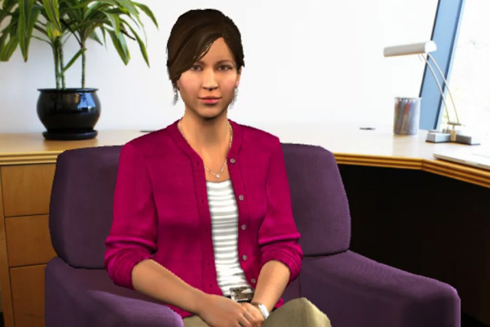
Distress Analysis Interview Corpus-WoZ
Corpus of audio/video recordings of patient interviews by USC ICT.
Virtual Human Ellie controlled by two humans
Interviews have Q&A nature.
Analyze these interviews – detect depression.
Each video has:
PHQ Binary Labels – Depressed/non-depressed
PHQ scores – severity of depression
Virtual Human ELLIE
Photograph: Teresa Dey/USC ICT

Slide 7
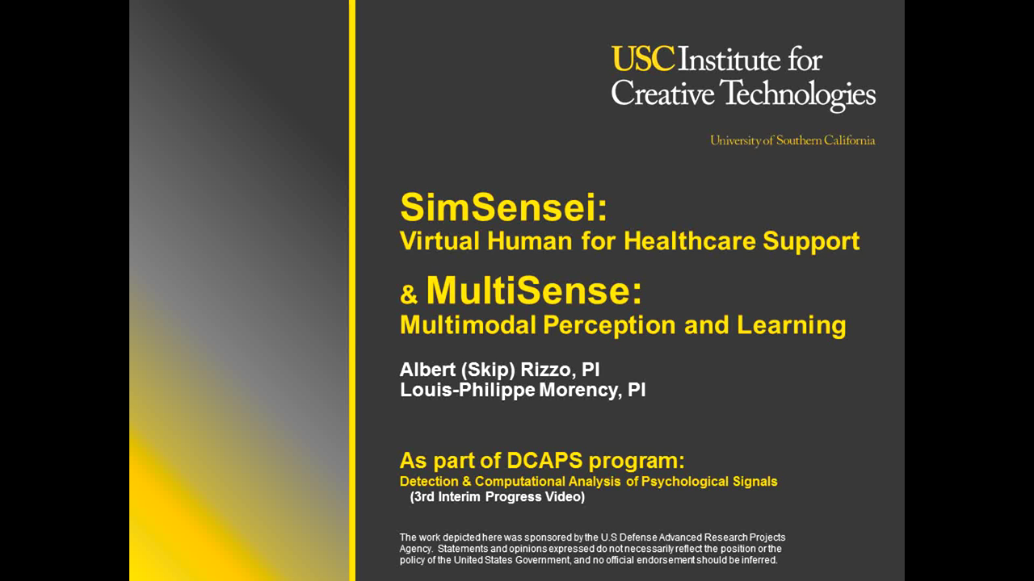

Slide 8
Prior Work
Yu et al represented the transcript as question-answer pairs.
Ghosh et al proposed a tri-modal approach which improved prediction
Questions in 3 categories: Intimate-Positive, Intimate-Negative, Non-intimate
Context-based classifier – Used simple Max Entropy model
Can we be more specific? We use only intimate questions
Notes:
Prior to Ghosh et al, all approaches were bi-modal.
Ghosh explored the effect of verbal and non-verbal cues, as well as contextual information (responses to questions)
We feel intimate questions have more information and hence, we explore only those questions.
We also propose an enhanced classifier for this project.

Slide 9
Question Extraction and Annotation
Questions paired with responses play an important role.
We split intimate questions using two ways:
Discriminative/Non-discriminative
Positive/Negative
Used only top 27 questions by frequency.
Notes:
Question Selection: Eliminate non-intimate questions

Slide 10
Question Categorization
“What are you most proud of in your life?” – Positive
“Is there anything you regret?” – Negative
“How have you been feeling lately?” – Discriminative
“How would your best friend describe you?” – Non-discriminative
Notes:
Discriminative: Responses from depressed and non-depressed people can be distinguished easily
Non-discriminative: Responses can’t be easily distinguished. Can’t clearly say whether the response is coming from a depressed or non-depressed person

Slide 11
Feature Extraction
Acoustic – FORMANT, COVAREP
Visual – FACET, CLM (HoG, Pose, Gaze, 2D, 3D)
Linguistic – LIWC (Word-level features)
Types of utterances by Ellie:
Intimate question
Non-intimate question
Follow-up question
Acknowledgement
How are the features extracted?

Slide 12
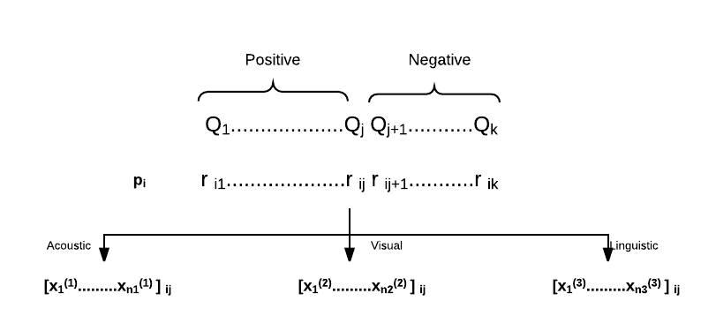
Notes:
At this point, we have the question categorizations and the extracted responses of the participants. For each participant, we take all the responses to positive questions together (lets call them positive responses) and those of negative questions together (lets call them negative responses). Each response is made up of three feature vectors, acoustic, visual and linguistic. We separate each response in this manner.
For each participant, we have a set of acoustic vectors, a set of visual vectors and a set of linguistic vectors for the positive responses. Similarly for the negative responses. Therefore, for each participant, we have extracted features of 3 modes for each of the 2 categories and thus end up with 6 feature matrices.

Slide 13
Feature Selection
Three major methods:
Removing low variance
L1 Norm
Select K best – ANOVA
Pipelined
Reduce to 20 features initially
Notes:
The feature selection was different for each category per mode. So six feature selection processes.

Slide 14
Data Preparation
Data Split:
Train: 107 videos
Test: 47 videos
Dev: 35 videos
15-18 Q&A pairs per video.
Late Fusion approach

Slide 15
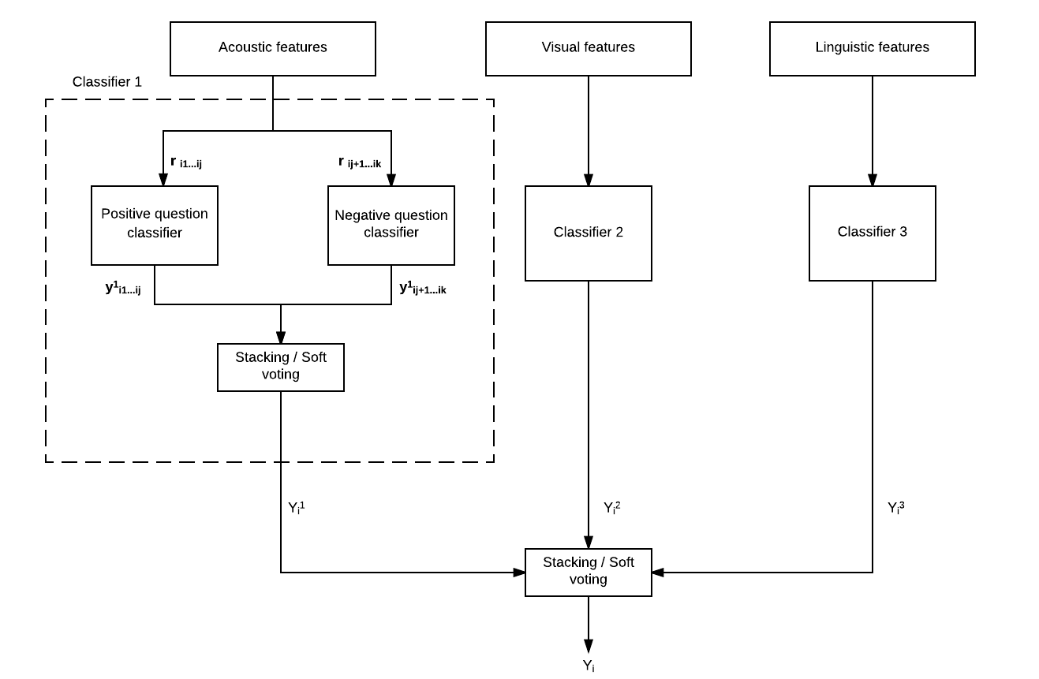
Notes:
Each response is a data point
Why average of y’s
Stacking, soft and hard voting
Why different weights for different modes

Slide 16
Predicting depression
Individual probability estimates for each response r_{ij} is obtained.
Average over probability estimates.
Each category (P/N, D/ND) is weighted unequally.
Combine estimates from both categories using Soft Voting – Get Binary Label (Depressed/Not Depressed)

Slide 17
Initial Results
Discriminative/Non-discriminative
Positive/Negative
Acoustic
Visual
Linguistic
Acoustic
Visual
Linguistic
0.50
0.55
0.44
0.53
0.62
0.44
0.4
0.4
0.5
0.1
0.4
0.2
0.55
0.67
Notes:
These are F-1 scores.

Slide 18
Work in progress
Find best combination of classifiers
Better Tuning of Hyperparameters
Depression Severity Estimation – Regression Problem

Slide 19
Challenges
Skewed Data – Not enough depressed instances
Not every response has verbal features – LIWC captures only certain parts of responses
Missing feature values for many frames

